Slide 1


Slide 2


Slide 3

Members’ Details
Sanjib Kumar Das
Sourav Biswas
Chirantan Das
Amrit Dhandharia

Slide 4
Enabling a Patient-Centered Information Exchange System
There would be a database where the details of the concerned patients will be stored, as per follows :-
NOTE: Newer records may be made either by viewing previous records of a patient or after a treatment.
It will be a database which supports new entry (for new patients) and also updatable (only by the doctor and associates) for patients with previous records.

Slide 5
A single id will be allotted in the database to each patient for further references.
NOTE: If a patient whose history has been already recorded in the database by any means forgets his/her id then phone number or DOB or Date of treatment along with other reports can be checked, if it doesn’t work out then new id will be allotted to him/her.
The database will be used to check the previous report of the patient and on that basis the future treatment will be executed.

Slide 6
The database would only be accessible by the doctors and the associates. The patient only can fill the required details as per the interface provides (i.e. bio or the previous id or can upload the reports of any external treatment as per requirement and conditions.
There would be a mandatory column to take input of the places the patient has visited recently and the current status of that place according to Covid-19 norms will be analyzed and recorded.

Slide 7
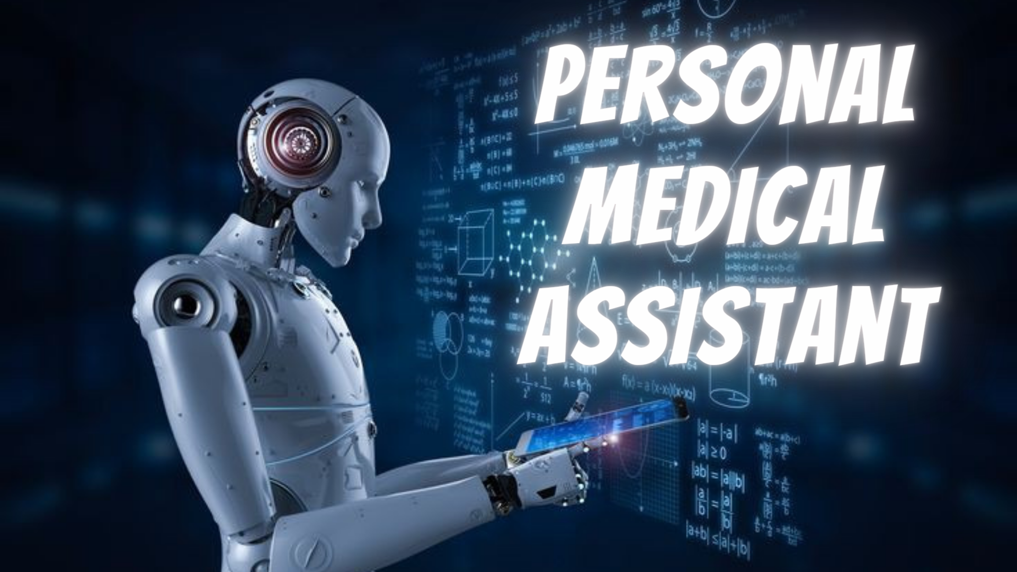

Slide 8

The assistant will be an AI based program who can access the database regarding the patient-centred information
A set of instructions is to be provided to the Assistance which can accept the regarding symptoms of the concerned patients and evaluate them along with the previous records to find the disease and its possible cures (self-suggested medicines, required test reports) and refer it to the doctor
The main function of the Assistant would be to fix a proper appointment with the doctor himself along with its own evaluated data or reports to the doctor

Slide 9

A separate database will be allotted to the AI to handle such common symptoms and suggest some cures after comparing with previous prescriptions
The assistant should not give any output to the patient until and unless the doctor verifies it
The Assistant would then update the patient-centred information database regarding the concerned patients

Slide 10
